Slide 1
TEXT TO SPEECH
Here is where our presentation begins

Slide 2
Zargul Zafar: 2022-BS-SE-093
Ashmal Sahifa Younus: 2022-BS-SE-121 Ammara Ahmad: 2022-BS-SE-110 Romaisa Tanveer: 2022-BS-SE-091

Slide 3
Introduction:
This Python application integrates Sentiment Analysis and Text-to-Speech (TTS) functionalities. Using VADER from the nltk library. Additionally, it converts the text into speech using the gTTS library, allowing the user to listen to the analysis. It offers an engaging way to explore sentiment analysis and generate audio outputs.

Slide 4
Models: Sentiment Analysis Model: Text-to-Speech Models:
01
02
03
VADER: Lightweight, rule-based, used in this project for quick sentiment scoring.
gTTS: Easy-to-use and free library, supports multiple languages and accents, used in this project.
Deep Learning Models: High accuracy but resource-intensive and require fine-tuning.
Deep Learning TTS Models: High-quality speech, computationally expensive.
Lexicon-Based Models : Simpler, uses predefined lexicons, but limited in handling context.
Open Source Libraries: Offline libraries, but lower voice quality compared to deep learning models.
Models Used in This Project?
Reason for Choice?

Slide 5
Libraries used in this code
tkinter: Creates and manages the GUI (buttons, labels, text boxes, etc.).
messagebox: Displays pop-up messages to provide user feedback.
nltk: Performs natural language processing tasks, including sentiment analysis.
SentimentIntensityAnalyzer: Analyzes short text to calculate sentiment polarity scores.
gTTS: Converts text into speech, generating audio files.
os: Manages files and executes system commands to play audio.
nltk.download: Downloads required datasets for sentiment analysis.

Slide 6
Functions:
1. analyze_sentiment_vader(text)
Purpose: Analyzes text sentiment using VADER.
Input: text (string) – The text to analyze.
Output: Sentiment (string) "POSITIVE", "NEGATIVE", or "NEUTRAL".
Scores (dict): Detailed sentiment scores (positive, neutral, negative, compound).
2. text_to_speech(text, filename="output.mp3")
Purpose: Converts text to speech using gTTS.
Input: text (string) – Text to convert.
filename (string, default "output.mp3") – Filename for the MP3.
Output: Plays an MP3 file.

Slide 7
3. get_user_input()
Purpose: Retrieves and validates user input from the GUI.
Input: None (retrieves text from GUI).
Output: User text (string) or None if input is empty.
4. convert_to_tts()
Purpose: Converts user input to speech.
Input: None (uses input from get_user_input()).
Output: Plays MP3, shows success message.
5. perform_analysis()
Purpose: Analyzes sentiment and updates GUI.
Input: None (uses input from get_user_input()).
Output: Updates GUI with sentiment results and converts
results to speech, plays it.

Slide 8
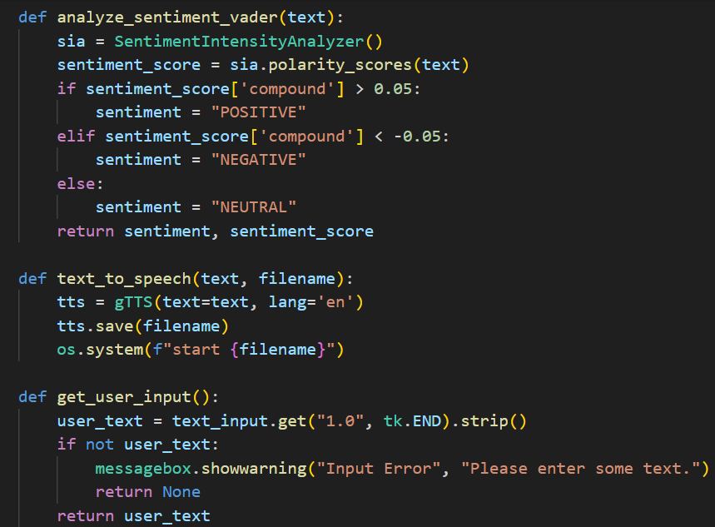

Slide 9
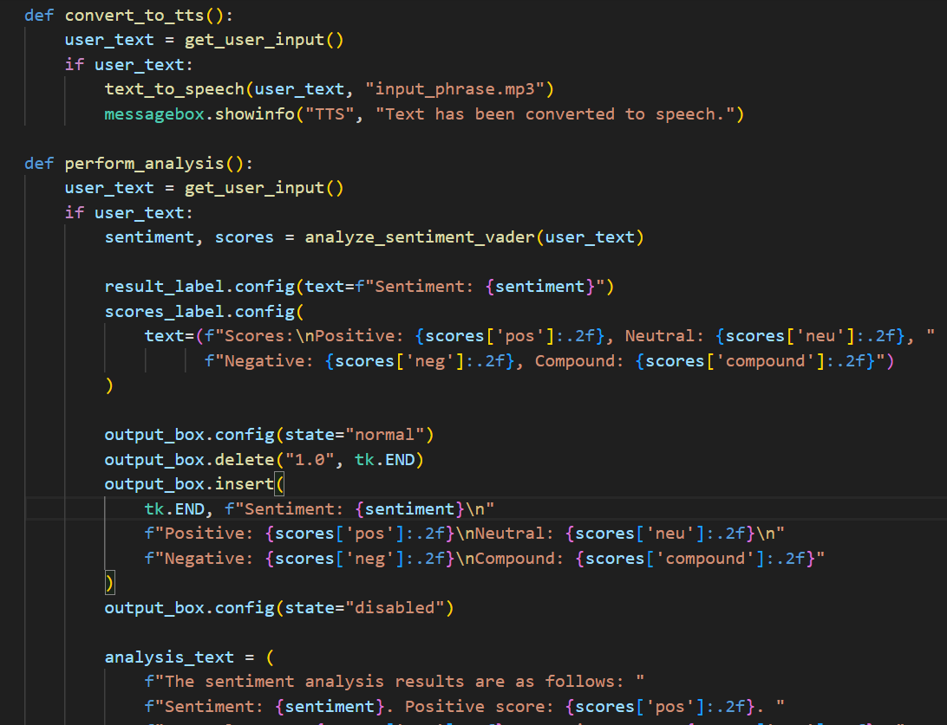

Slide 10
GUI Layout and Function Bindings
This part focuses on:
Setting up the main application window.
Defining functions for user interaction
Perform both Text-to-Speech (TTS) and Sentiment Analysis.
Exit the application gracefully.
Customizing the graphical user interface (GUI).

Slide 11
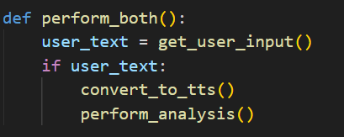
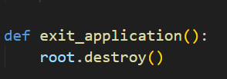
Function 1 - Perform Both Actions
Objective: Combine the Text-to-Speech and Sentiment Analysis functionalities.
Steps:
1. Fetch the user's input (get_user_input()).
2. Convert the input text into speech using convert_to_tts.
3. Analyze the sentiment using perform_analysis.
Purpose: Simplifies the user's experience by allowing them to trigger two features simultaneously.
Function 2 - Exit Application
Objective: Close the application gracefully.
Mechanism: root.destroy() ends the Tkinter main loop and clears any ongoing processes.
Purpose: Provides a simple and efficient way to exit the program.
Avoids leaving any background processes running.

Slide 12

Main Application Window Setup:
Explanation:
t k.Tk(): Creates the main window.
title("..."): Sets the window title.
geometry("900x700"): Defines the window size (900x700 pixels).
resizable(True, True): Allows resizing horizontally and vertically.
config(bg="#ffffff"): Sets the background color to white.
Purpose:
•Initializes the GUI with a visually appealing layout and functional space for user interaction

Slide 13
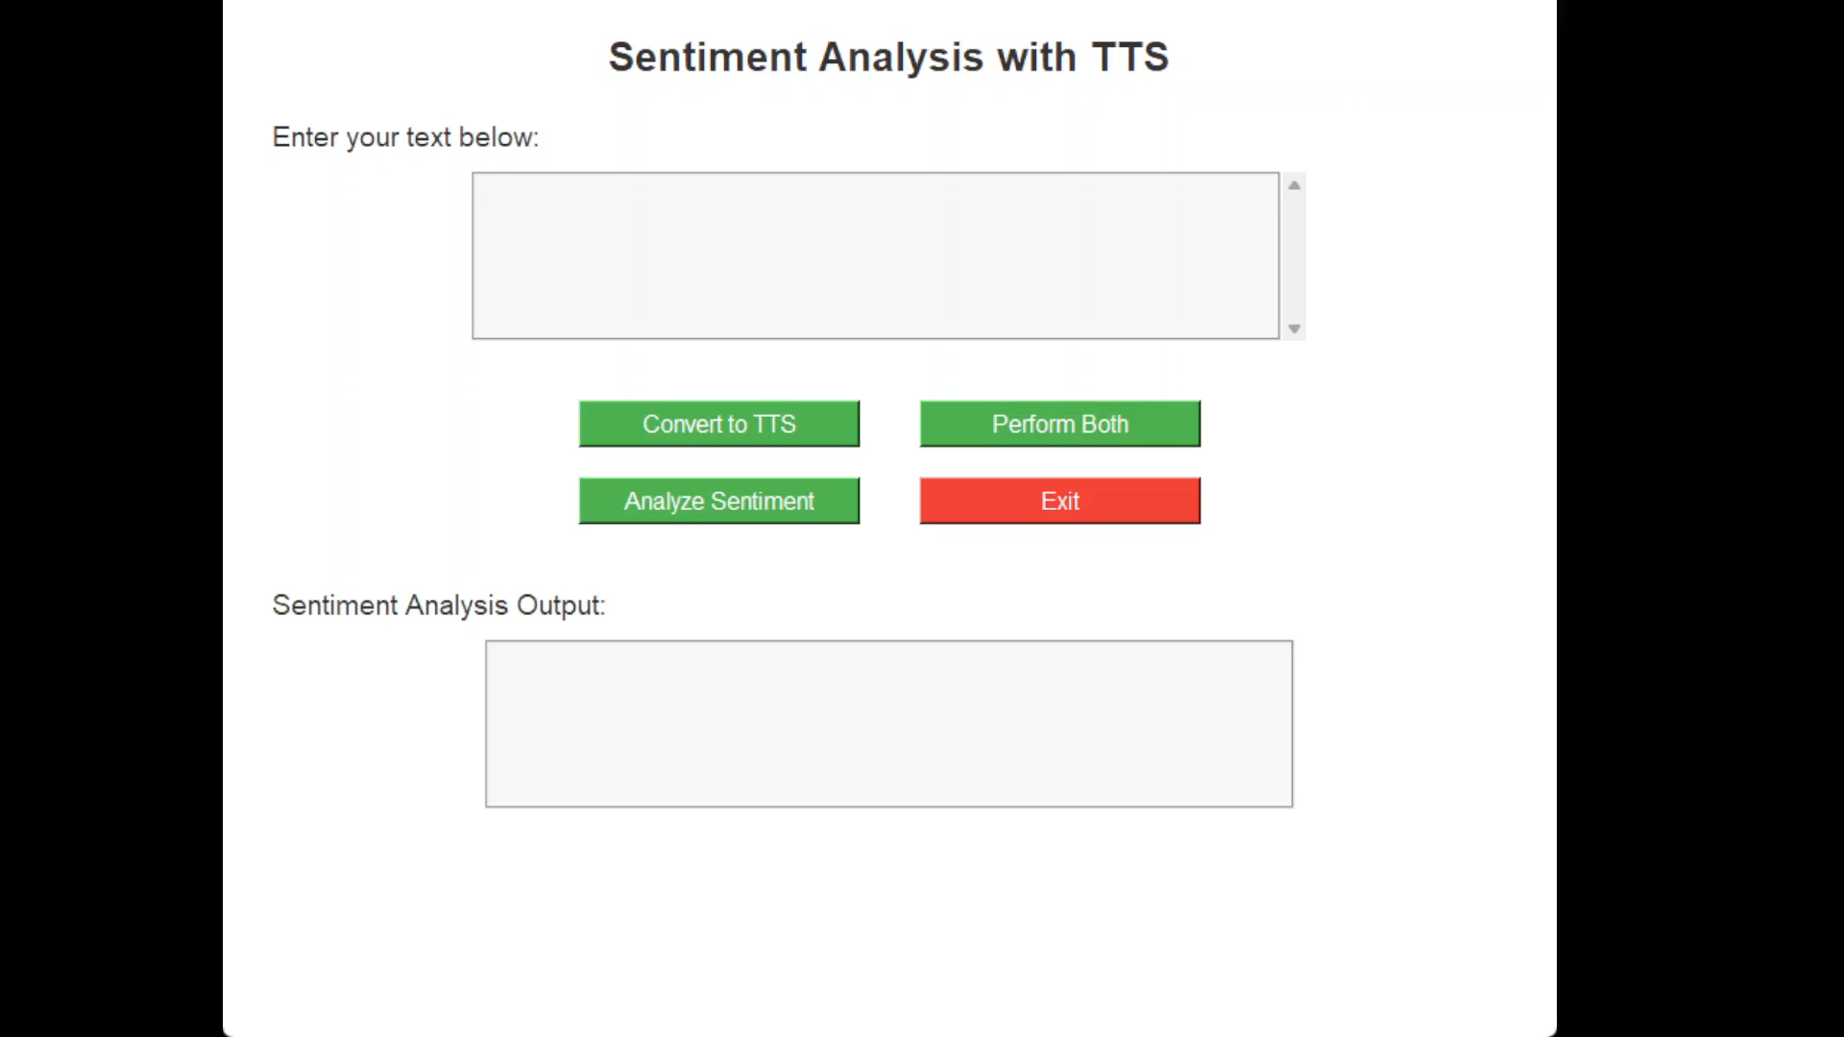

Slide 14
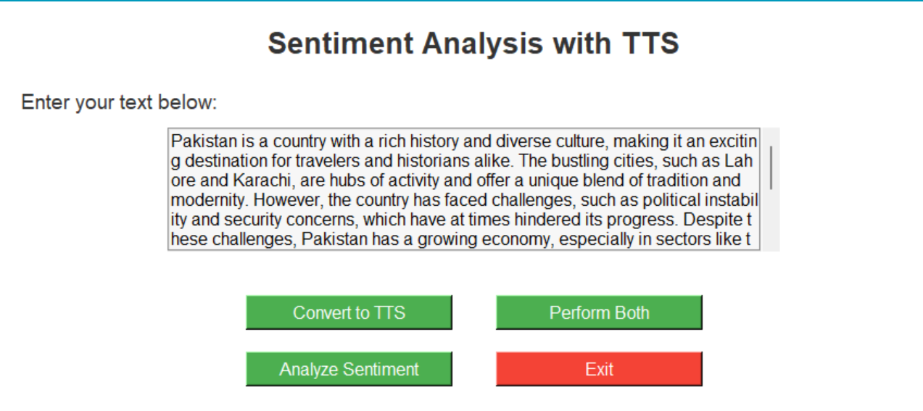
GUI Widgets:
1. Heading Label:
Text: "Sentiment Analysis with TTS"
Font: Helvetica, 20, Bold
Position: At the top, with padding for spacing.
2. Text Input Section:
Label: "Enter your text below:"
Font: Helvetica, 14
Text Box: A multi-line input field for user text (Height: 6, Width: 60).
Font: Helvetica, 12
3. Buttons:
Convert to TTS: Converts entered text to speech.
Analyze Sentiment: Analyzes sentiment of entered text.
Perform Both: Executes both text-to-speech and sentiment analysis.
Exit: Closes the application.

Slide 15
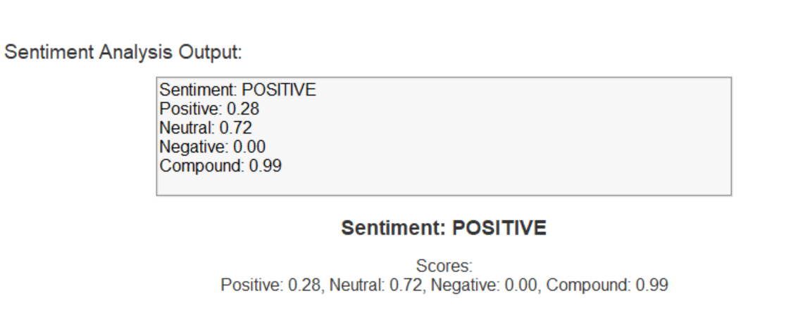
Result Display and Output Section
1. Sentiment Analysis Output:
Label: "Sentiment Analysis Output"
Text Box: Displays detailed sentiment results (Positive,
Neutral, Negative, Compound scores).
2. Sentiment Result:
Label: Shows the overall sentiment (Positive,
Negative, Neutral).
3. Sentiment Scores:
Label: Displays detailed sentiment scores
(Positive, Neutral, Negative, Compound). This structure summarizes the GUI widgets and
their layout for the application.

Slide 16
Uses:
1. Accessibility:
The application's text-to-speech functionality makes it accessible to users with visual impairments.
2. Sentiment analysis:
The application's sentiment analysis functionality can be used to analyze customer feedback, reviews, and social media posts.
3. Education:
The application can be used as a teaching tool to help students learn about NLP and sentiment analysis.

Slide 17
Pros and Cons:
Pros | Cons
User-friendly interface: The application has a simple and intuitive interface that makes it easy for users to interact with. | Limited functionality: The application only provides sentiment analysis and text-to-speech functionality, which may not be sufficient for more complex NLP tasks
Sentiment analysis: The application uses NLTK's VADER sentiment analysis tool to provide accurate sentiment analysis results. | Dependence on external libraries: The application relies on external libraries like NLTK and gTTS, which may have their own limitations and dependencies.
Text-to-speech functionality: The application uses gTTS to convert text to speech, making it accessible to users with visual impairments. | Limited customization options: While the application allows users to input their own text, it does not provide many customization options for the sentiment analysis and text-to-speech functionality.

Slide 18
Conclusion:
This project demonstrates the use of Python, Tkinter, NLTK, and gTTS libraries to build a sentiment analysis and text-to-speech application. While the application has its limitations, it provides a useful tool for users who want to analyze sentiment and convert text to speech. With further development and customization, this application can be used in a variety of contexts, including accessibility, education, and customer feedback analysis.

Slide 19
THANK YOU

